Slide 1
PROJECT REPORT ON ENCRYPTION OF IMAGE USING TRIPLE DES

Slide 2
ABSTRACT
The process of encrypting information or data in order to prevent unauthorised access is known as encryption. These days, we must protect information stored on our computers or communicated over the internet against cyber-attacks. We will use the triple des algorithm to encrypt and decrypt the image in this project. When we encrypt an image, we use a key, and when we decode the image, we also use the same key. This project works in the following way: the sender encrypts the image with a key and transmits it to the receiver; the receiver must then decode the image with the same key.So we can say that we can protect data from cyber attacks and transfer any classified information from one to other.In this project we use TRIPLE DES Algorithm for encryption and decryption of data. TRIPLE DES algorithm is used to protect many cyber attacks like : Man-in-the-middle,Block collision attack and System32 attack .

Slide 3
INTRODUCTION
Cybersecurity refers to a range of techniques for protecting networks, programmes, and data from attack, injury, and unauthorised access. Information security is a subset of cybersecurity that aims to protect data's confidentiality, integrity, and availability. Cyber security may aid in risk management and help prevent cyber attacks, data breaches, and identity theft. Cyber security is also a collection of ideas and practises that protects us from hackers, cyber criminals, and other fraudsters. It focuses on people, processes, and technologies that help with vulnerability reduction, online threats, deterrent, and online frauds and attacks.

Slide 4
EXISTING SYSTEMS
Symmetric encryption
Symmetric encryption is nothing but this type of algorithms uses same key for encryption and decryption. There are hundreds of symmetric key algorithms in existence, which you may or may not be aware of! AES, RC4, DES, 3DES, RC5, RC6, and other encryption algorithms are some of the most popular. The DES and AES algorithms are the most well-known of these algorithms.
Asymmetric encryption
Asymmetric encryption is nothing but in this type of algorithms uses multiple keys for encryption and decryption .It has public key and private key .Asymmetric encryption is also called public key cryptography.
RSA and ECC Asymmetric encryption algorithms most commonly used.

Slide 5
PROPOSED SYSTEMS
Digital encryption of image on chaos throey
Chaotic methods are being used in a variety of domains, including cryptosystem design and picture encryption. Digital picture encryptions based on chaotic algorithms are a new type of image encryption. This technology encrypts images using random chaotic sequences, and it is a very secure and quick way of image encryption. The technique is run in MATLAB, and a comparison is made in terms of various performance metrics such as the Number of Pixels Change Rate (NPCR), Peak Signal to Noise Ratio (PSNR), Correlation coefficient, and Unified Average Changing Intensity (UACI). Limited accuracy is one of the disadvantages of this technique.

Slide 6
ARCHITECTURE
ENCRYPTION
Normal image
Triple DES algorithm is
performed on image
encrypted image

Slide 7
DECRYPTION
encrypted image
Triple DES algorithm is on
encrypted image
Decrypted image

Slide 8
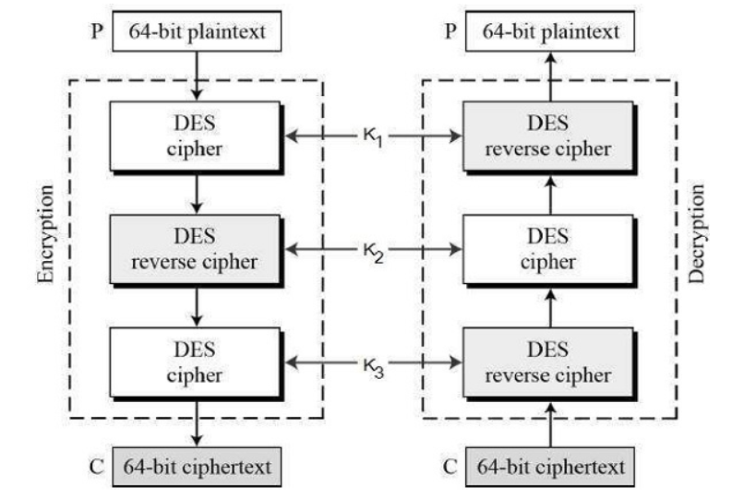
TRIPLE DES ALGORITHM
Triple DES algorithm is more secure than DES and Double DES algorithms.In
Triple DES the DES is performed thrice on plain text/image for encryption and as well as decryption . In triple DES it uses three security keys for encryption and decryption

Slide 9
METHODOLOGY
Firstly we should run our code ,then the code will run and it will ask us to select options 1.Encryption and 2.Decryption
We should as option 1 and after this it asks for image file path
We should give the path of the image ,then after this it will asks for key(password) . we should give the password give our password.
After this all steps the image file will be encrypted.
We should repeat same process for Decryption as well.
This process works not only for images but also for other files like: text document,pdf etc

Slide 10
SOFTWARE REQURIMENTS
Pycharam community/vs code/spyder IDE
Windos /macos/linux

